Slide 1
Personal Finance Management
Objectives:
1. To create awareness and educate consumers on access to financial services.
2. To make the students understand the basic concepts, definitions and terms related to direct taxation.
3. To help the students compute the Goods and Service Tax (GST) payable by a supplier after considering the eligible input tax credit.
4. To familarise the students with microfinance for accelerating the expansion of local microbusinesses.

Slide 2
Outcomes: On completion of the course, learner will be able to:
Use a framework for financial planning to understand the overall role finances play in his/her personal life.
Compute income from salaries, house property, business/profession, capital gains and income from other sources.
Compute the amount of CGST, SGST and IGST payable after considering the eligible input tax credit.
Understand how Microfinance can help in financial inclusion.

Slide 3
Module 1
Overview of Indian Financial System: Characteristics, Components and Functions of Financial System. Financial Instruments and Financial Markets, Financial inclusion.
Introduction to Personal Finance
Person Financial Planning in Action, Money Management Skills, Taxes in Your Financial Plan, Savings and Payment Services. Consumer Credit: Advantages, Disadvantages, Sources and Costs

Slide 4
Module 2
Personal Financial Management
Loans: Home, Car, Education, Personal, Loan against property and Jewel loan.
Insurance: Types of Insurance – ULIP and Term; Health and Disability Income Insurance, Life Insurance.
Investment: Investing Basics and Evaluating Bonds, Investing in Stocks and Investing in Mutual Funds, Planning for the Future.

Slide 5
Module 3
Income Tax
Income Tax Act Basics- Introduction to Income Tax Act, 1961
Heads of Income and Computation of Total Income and Tax Liability- Heads of Income and Computation of Total Income under various heads, Clubbing Provisions, Set off and Carry forward of Losses, Deductions, Assessment of Income and tax liability of different persons.
Tax Management, Administrative Procedures and ICDS - TDS, TCS and Advance Tax Administrative Procedures, ICDS.

Slide 6
Module 4
Goods and Services Tax
GST Constitutional framework of Indirect Taxes before GST (Taxation Powers of Union & State Government); Concept of VAT: Meaning, Variants and Methods; Major Defects in the structure of Indirect Taxes prior to GST; Rationale for GST; Structure of GST (SGST, CGST, UTGST & IGST); GST Council, GST Network, State Compensation Mechanism, Registration.
Levy and Collection of GST
Taxable event- "Supply" of Goods and Services; Place of Supply: Within state, Interstate, Import and Export; Time of supply: Valuation for GST- Valuation rules, taxability of reimbursement of expenses; Exemption from GST: Small supplies and Composition Scheme: Classification of Goods and Services

Slide 7
Module 5
Introduction to Micro – finance
Micro-Finance: Definitions, Scope & Assumptions, Types of Microfinance, Customers of Micro-finance, Credit Delivery Methodologies, SHG concept, origin, Formation & Operation of Self Help Groups (SHGs).
Models in Microfinance - Joint Liability Groups (JLG), SHG Bank Linkage Model and GRAMEEN Model: Achievements & Challenges,
Institutional Mechanism
Current Challenges for Microfinance, Microfinance Institutions (MFIs): Constraints & Governance Issues, Institutional Structure of Microfinance in India :NGO-MFIs, NBFC-MFIs, Co-operatives, Banks, Microfinance Networks and Associations; Demand & Supply of Microfinance Services in India, Impact assessment and social assessments of MFIs,

Slide 8
Evaluation Scheme:
Semester End Examination (A):
Theory:
Question paper based on the entire syllabus will comprise of 5 questions (All compulsory, but with internal choice as appropriate), each carrying 15 marks, total summing up to 75 marks.
Total duration allotted for writing the paper is 3 hrs.
Continuous Assessment (B):
Theory:
Consisting One Class Tests for 25 marks based on approximately 50% of contents and one case study with presentations for 25 Marks.
Total duration allotted for writing test paper is 1 hr.
Average of the marks scored in the tests and case study will be considered for final grading.

Slide 9
“Why do I need to learn about finance.. I am very good in my own area of specialization”
How would you react to the above statement?

Slide 10
Financial System
For economic transformation of a country, the financial system is the key for the institutional and functional vehicle.
Finance assists in reducing the gap between the present and the future, and covers every aspect like channelization and effective usage of savings and making an efficient investment.
It formulates the base, the sets and the tone for the accomplishment of wider national objectives.

Slide 11
According to Robinson, the primary function of the financial system is:
"To provide a link between savings and investment for the creation of new wealth and to permit portfolio adjustment in the composition of the existing wealth".
According to Christy, the objective of the financial system is to :
"Supply funds to various sectors and activities of the economy in ways that promote the fullest possible utilization of resources without the destabilizing consequence of price level changes or unnecessary interference with individual desires".

Slide 12
A financial system acts as an intermediary where there is surplus and deficiency of funds. It bridges the gap between the two segments
It comprises of various institutions, markets, regulations, laws. money managers, experts and many others.
In the context of "Financial System" the term system means a sequence of complex and closely attached variables like institutions, agents, practices, markets, transactions, claims and liabilities in an economy.

Slide 13
Characteristics of Financial system
Financial system establishes a link between the one having surplus funds with those who are in need of such funds. Both the investment and the savings aspects are encouraged.
Financial system contributes towards the expansion and the development of financial markets.
Financial system facilitates the efficient allocation of financial resources for the benefit of the society and the public at large.
Financial system boasts the economic quality and accelerates economic development.
Financial system lays the foundation for an ideal economy.
Financial system builds an efficient portfolio for the fund seeker.
Financial system reduces the transaction costs.
Financial system ensures availability of all the price-related information.

Slide 14
Functions of Financial System
To Connect the Investors with the Savers
Assistance in Selection of a Project
Risk Allocation
Availability of Information
Reducing the Cases of Asymmetric Information
Reduction in the Borrowing and the Transaction Cost
Liquidity Promotion
Financial Broadening and Deepening

Slide 15
Components of Financial System
Financial Institutions
Financial Markets
Financial Instruments/ Securities/Assets
Financial Services

Slide 16
Financial Institutions

Slide 17
Financial Institutions
Different kinds of organisations which act as an intermediary and facilitator in financial transactions at the individual and the corporate level are included in the term financial institutions.
Covers both the institutions providing finance and the investing institutions in it. They are the ones who channelize the savings and allocate the funds in the most optimum manner.
Classified in three different categories :
Regulatory Institutions
Banking Institutions
Non-banking Institutions

Slide 18
Regulatory Institutions
Regulatory are the ones who provides rules and guidelines for a particular market.
It comprises of RBI, SEBI, IRDA, AMC, etc. Primarily, an investor would want the funds to be under the control and to be safe to invest. This assurance is rendered by the regulatory authority that is regulating the particular market.
For example, money market instruments are regulated by the RBI whereas the capital market instruments are regulated by SEBI.

Slide 19
Banking Institutions
The banking institutions are of two types
Intermediaries
Intermediaries are the ones who fulfil the short-term requirement of funds of corporate as well as the individual clients. They comprise of banking as well as non-banking intermediaries.
For example, banks like SBI, PNB, etc. whereas examples of non-banking intermediaries comprise of GIC, UTI. LIC, etc.
Other important services like credit rating, leasing. merchant banking, hire-purchase are also provided by these financial intermediaries. These services are required while creating a new firm, during expansion and the economic growth.

Slide 20
The two types of banking intermediaries are as follows :
i) Commercial Banks :
These banks hold deposits on behalf of the customers and thus ensure the safety of the funds. The primary purpose was thus to hold the same for the customers who do not wish to hold the same on their own. As a result, the need for the customers to keep funds in the form of cash has reduced and he can thus use the services of credit cards, cheques, net banking for entering into any financial transaction. These banks also provide loans to individuals and businesses for long-term purposes and also for financing the working capital requirements.
ii) Co-operative Bank :
The co-operative banks give financial help to the agriculture sector and also helps in establishing the credit system. It basically helps the rural areas of the country as commercial banks are not able to reach the rural areas. The long-term loans are required for purchasing of land or permanent improvement on land which is provided by the land development bank and the short-term loan is provided for purchasing implements, fertilizers and seeds, etc. which is given by the co-operative banks.

Slide 21
2) Non-Intermediaries :
They are engaged in providing funds on long-term basis to individuals as well as corporate clients. They comprise of institutions who are lending on term basis.
For example, financial corporations and investment institutions like IDBI, NABARD, IFCI, etc.

Slide 22
Non-Banking Institutions
The non-banking includes following institutions :
1) Non-Banking Financing Institutions (NBFI) :
A Non-Banking Financing Institution (NBFI)/Non-Banking Financing Intermediary has alternate roles in different parts of the world :
It is an institution which is not just a bank but is engaged in the function of finance.
Financial institutions who do not accept demand deposits.
Financial institutions who do not accept any deposit.
2) Investment Companies :
They may be called a trust or a corporation which facilitates an individual to invest in different diversified and professionally managed securities by arranging pool of funds from other investors. The individual need not invest in single company stocks but can rather purchase units directly from the investing company which are well diversified. For example, UTI and Mutual Fund.

Slide 23
3) Insurance Companies :
They create a risk pool by way of collection of premium from the people at large who wishes to buy a protection either for a person or for a property. It helps to mitigate the loss and preserve the wealth and meet out the uncertainties. By insuring large groups, risk is spread over the entire insured and even in the event of paying claims, they end-up with sufficient amount of profits unless there is a natural calamity or disaster.

Slide 24
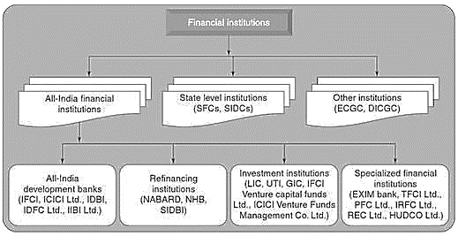
IFCI, Industrial Finance Corporation of India
The Industrial Investment Bank of India (IIBI)
Industrial Development Bank of India (IDBI)
National Bank for Agriculture and Rural Development (NABARD)
National Housing Bank (NHB) as the Common Nodal Agency for both Schedule Commercial Banks (SCBs) and Housing Finance Companies (HFCs)
Small industrial Development Bank of India (SIDBI)
Tourism Finance Corporation of India Ltd. (TFCI)
Housing and Urban Development Corporation Ltd. (HUDCO)

Slide 25
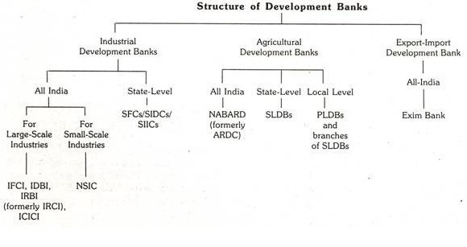
State Land Development Bank (India)
State Finance Corporations (SFCs)
SIDC states industrial development corporation
Primary Land Development Bank
State Industrial Investment Corporation (SIIC)
National Small Industries Corporation (NSIC) Bank

Slide 26
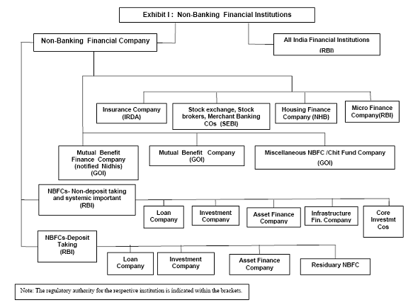
Non-Banking Financial Company (NBFC)

Slide 27
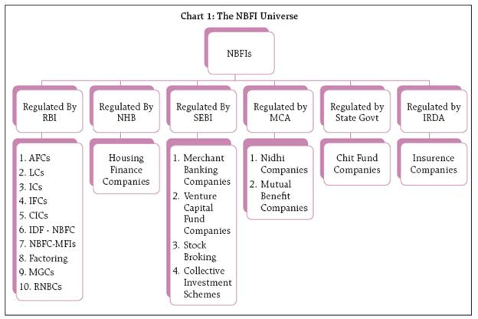
Ministry Of Corporate Affairs
As depicted above, RBI classifies NBFCs into ten categories namely Asset Finance Companies(AFCs), Loan Companies(LCs), Investment Companies (ICs), Infrastructure Finance Companies(IFCs), Core Investment Companies(CICs), Infrastructure Debt Funds (IDF-NBFCs), NBFC-Microfinance Institutions (NBFC-MFIs), Factoring companies(FCs), Mortgage Guarantee Companies (MGCs) and Residuary Non- Banking Companies(RNBCs).

Slide 28
Commercial bank
The primary functions of a commercial bank are accepting deposits and also lending funds. Deposits are savings, current, or time deposits. Also, a commercial bank lends funds to its customers in the form of loans and advances, cash credit, overdraft and discounting of bills, etc.

Slide 29
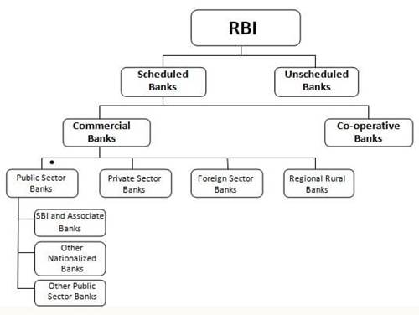

Slide 30
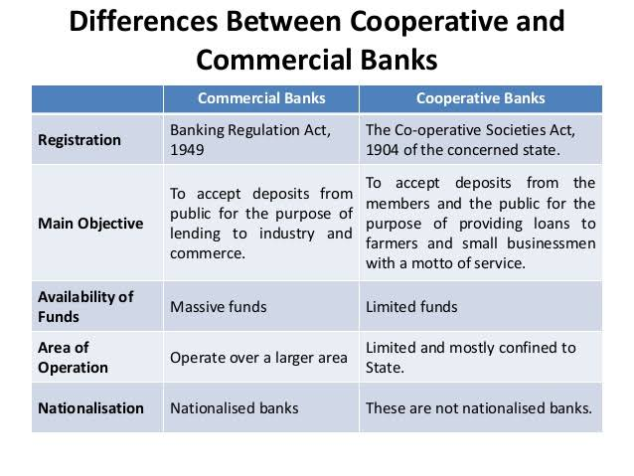

Slide 31
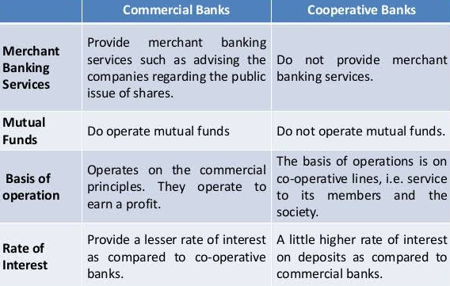

Slide 32
Functions of Commercial bank
Commercial banks provide retail banking services to household and business customers
They are licensed deposit-takers – providing a range of savings accounts
They are licensed to lend money (and thereby “create” money e.g. in the form of bank loans, overdrafts and mortgages
Commercial banks are profit-seeking
A commercial bank’s business model relies on receiving a higher interest rate on the loans (or other assets) than the rate it pays out on its deposits (or other liabilities)
This “spread” on their assets and liabilities is used to pay the operating expenses of a bank and also to make a profit.

Slide 33
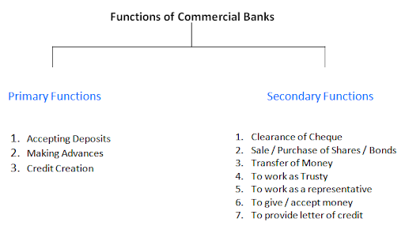

Slide 34
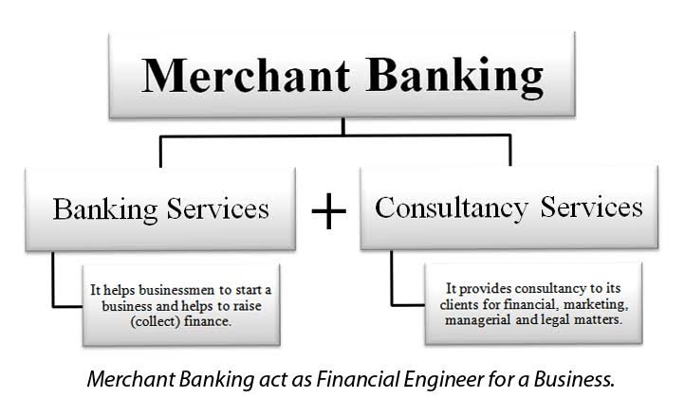

Slide 35
Merchant Banks
A merchant banker usually refers to a firm or organization involved in all aspects of issue management. Their services include providing consultancy or advisory services to corporates for issue management, making arrangements for buying, selling or subscribing to shares in an issue or any other consultancy or services such as underwriting, analysis and advice related to mergers and acquisitions, arranging offshore funding or venture capital, credit syndication and portfolio management.

Slide 36
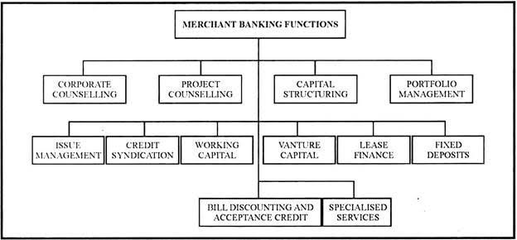
Functions of Merchant Banks

Slide 37
Leading merchant bankers in India
Public sector: SBI Capital Markets, Punjab National bank, IFCI Financial Services
Private sector: ICICI Securities, Axis Bank, Bajaj Capital, Tata Capital Markets, Yes Bank, Kotak Mahindra Capital Company, Reliance Securities
Foreign merchant bankers: Goldman Sachs (India) Securities, Morgan Stanley India, Barclays Securities (India), Bank of America, Citigroup Global Markets India

Slide 38
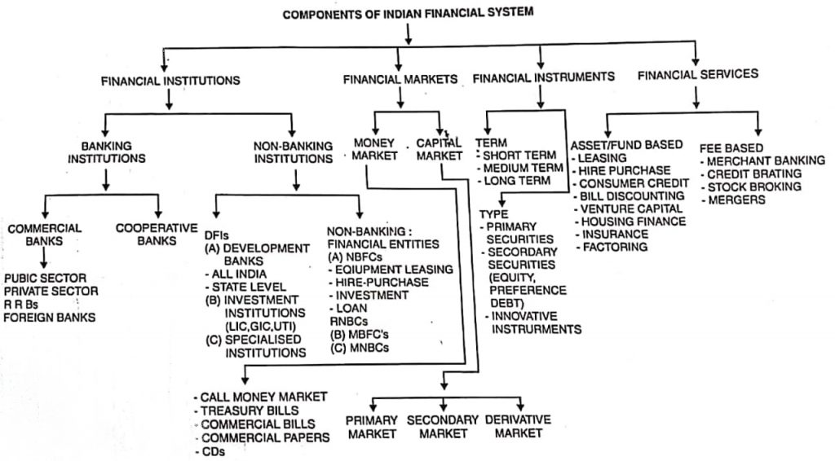

Slide 39
Financial Markets

Slide 40
Financial Markets
There does not exist a physical or geographical location that can be termed as a financial market but all the financial transactions are deemed to occur in the financial market. So, it can be said that as financial transactions are pervasive in nature, financial markets are also pervasive.
A financial market is a common place where the buyers and the sellers of financial instruments meet and exchange products. Stock exchange may be termed as a place where these transactions take place and a location for the financial market.
In India, financial markets are classified as unorganized and organised markets.

Slide 41

STRUCTURE OF MONEY MARKETS
ORGANISED MONEY STRUCTURE
UNORGANISED MONEY STRUCTURE

Slide 42
ORGANISED MONEY STRUCTURE
PARTICIPANTS:
Reserve bank of India.
DFHI (discount and finance house of India)
Commercial banks:-
Public sector banks
SBI with 7 subsidiaries Cooperative banks
20 nationalized banks
Private banks
Indian Banks Foreign banks
Development bank
IDBI, IFCI, ICICI, NABARD, LIC, GIC, UTI etc.

Slide 43

UNORGANISED SECTOR
Indigenous
Money lenders
Unregulated Intermediaries
aries

Slide 44
INDIGENEOUS BANKS
Private firms that receive deposits and give loans and thereby operate as banks
As activities are not regulated properly ,they are unorganized segment
Broadly classified into 4 groups- GUJRATI SHROFFS, MULTANI SHROFFS, CHETTIARS AND MARWARI KAYAS

Slide 45
MONEY LENDERS
Broadly classified into 3 categories:
PROFESSIONAL MONEYLENDERS
ITINERANT MONEYLENDERS
NON PROFESSIONAL MONEYLENDERS

Slide 46
UNREGULATED INTERMEDIARIES
FINANCE COMPANIES- gives loans to the retailers, artisans and other self-employed persons
CHIT FUNDS- are saving institutions
NIDHIS- operate in unregulated credit market and provide kind of mutual benefit funds

Slide 47

KINDS OF FINANCIAL MARKET
Financial market is classified in two types of market

Slide 48
MONEY MARKET
It means a ready market or a short-term market where securities are bought or sold only for a very short duration.
The tenure usually does not exceed one year thus is considered to be an equivalent to cash only.
The securities are highly liquid in nature and can be readily converted to the cash.
The transaction cost is also the minimum.

Slide 49
DISADVANTAGES OF MONEY MARKET
Absence of integration
Shortage of funds
Lower rate of return
Larger amount of transaction fee

Slide 50
CAPITAL MARKET
It is a market where securities are usually held for long-term basis, i.e., more than one year. They do not have a fixed maturity or expiry date. The buyer can hold the same, till the time he wishes to do so.
1) Equity Market :
It comprises of the equity shares of the company. Equity shares are further classified in two categories :
i) Primary Market :
Where the shares are. being sold for the very first time, i.e., Initial Public Offer (IPO) and Right Issues.
ii) Secondary Market :
Where the existing shares are bought or sold, after they were originally issued to the public. These shares are listed on stock exchange through which they can be traded.

Slide 51
2) Debt Market :
It is the financial market in which debt securities are bought and sold by the investors.
These securities are in the nature of bonds or debentures and carry a fixed rate of return.
They are fixed income bearing securities that are issued by the Central and State Governments municipal corporations, other government bodies, and commercial entities like financial institutions, banks, PSU, public limited companies, etc.

Slide 52
Financial Instruments/ Securities/Assets

Slide 53
3 Types of Financial Instruments
Money market instruments.
Capital market instruments.
Hybrid instruments.

Slide 54
On the basis of term the financial instruments can be classified into following three types:
Short-Term
Long-Term
Medium-Term
1) Short-Term Financial Instruments:
The short-term financial instruments include the instruments which are of less than one year. The various types of securities are T-bills and commercial paper. The different kinds of cash can be deposits, certificate of deposits, etc. which are as follows :

Slide 55
Money market instruments
Call/Notice Money
Treasury Bills
Term Money
Certificate of Deposit
Commercial Papers

Slide 56
COMPOSITION OF MONEY MARKET
Call /Notice-Money Market
Call/Notice money is the money borrowed or lent on demand for a very short period. When money is borrowed or lent for a day, it is known as Call (Overnight) Money.
Intervening holidays and/or Sunday are excluded for this purpose. Thus money, borrowed on a day and repaid on the next working day, (irrespective of the number of intervening holidays) is "Call Money".
When money is borrowed or lent for more than a day and up to 14 days, it is "Notice Money". No collateral security is required to cover these transactions.

Slide 57
Treasury Bills:
Treasury bills show the responsibilities of Government of India.
It is basically of 91 days and 364 days. They are given to the customers on the auction basis every week which has certain small denominations which are issued by the Reserve Bank of India.
It does not have any specific interest rate so they are sold on discount or are redeem at par.

Slide 58
Inter-Bank Term Money
Inter-bank market for deposits of maturity beyond 14 days is referred to as the term money market.
The entry restrictions are the same as those for Call/Notice Money except that, as per existing regulations, the specified entities are not allowed to lend beyond 14 days.

Slide 59
Certificates of Deposit (CD):
CD is also a money market instrument issued by banks to the depositors, in the form of certificate showing the existence of such deposit with them.
These certificates are in turn traded by the depositors (when such a need arises) between their business associates.
In short, under this arrangement, the Bank deposit may be transferred from one owner to another, any number of times, before its maturity.
Interest on such deposits continues to be paid in the normal course.
The price of CD depends on the (a) Rate of interest available on the Bank Deposit (which is fixed), and (b) Rate of interest prevailing in the market at that particular time.

Slide 60
Commercial Paper (CP):
A commercial paper is an unsecured promissory note and money market instrument, issued by large corporate houses for raising funds with a view to meeting their short-term debt obligations such as payroll.
CP is not secured by collateral security. It is supported by an issuing bank or company who promise to pay the face value at the maturity date indicated on the note,
As it is an unsecured instrument, only the organizations with exceptional credit ratings are capable of issuing their commercial paper at an economical price.
The maturity period of Commercial Paper ranges between 15 days and one year. On maturity date, the issuer has to repay the due amount without any delay. There is no provision of grace period in this case.

Slide 61
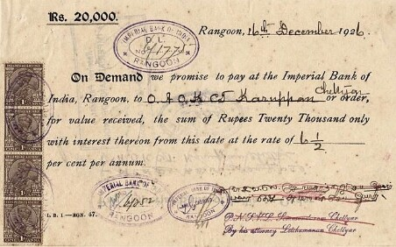
Merits of Commercial Paper
Technically, it provides more funds compared to other sources. The cost of commercial paper to the issuing firm is lower than the cost of commercial bank loans.
It is in freely transferable nature, therefore it has high liquidity also a wide range of maturity provide more flexibility.

Slide 62
Merits of Commercial Paper
A commercial paper is highly secure and does not contain any restrictive condition.
Companies can save their extra funds on commercial paper and also earn some good return on the same.
Commercial papers produce a continuing source of funds. This is because their maturity can be tailored to suit the needs of issuing firm. Again, commercial paper that matures can be repaid by selling the new commercial paper.

Slide 63
Limitations of Commercial Paper
Only financially secure and highly rated organizations can raise money through commercial papers. New and moderately rated organizations are not in a position to raise funds by this method.
The amount of money that we can raise through commercial paper is limited to the deductible liquidity available with the suppliers of funds at a particular time.
Commercial paper is an odd method of financing. As such if a firm is not in a position to redeem its paper due to financial difficulties, extending the duration of commercial paper is not possible.

Slide 64
2) Medium-Term Financial Instruments
The medium-term instruments consist of the instruments which has the maturity of 1 to 5 years. The various types of medium-term instruments are as follows :
i) Bank Deposits :
In bank deposits, an individual opens a bank account and deposit the money in that. The different kinds of bank accounts are current accounts, fixed deposits, term deposits, savings bank account, recurring deposits, post office deposits, public provident fund, employee provident fund scheme, etc.
ii) Mutual Funds :
A mutual fund is referred to as collection of investment scheme which has the money from various sources and is professionally managed. The investment is done in stocks, bonds, short-term money market instruments and other securities. Hence, it helps the investors to earn more profits of diversified portfolio.
iii) Life Insurance :
The life insurance provides the protection to the policyholder from any uncertain situation like death or long-term sickness and disability which may affect the financial condition of the policyholders. These policies help the policyholder to arrange for funds required for certain work like regular income at the time of retirement or repayment of loan

Slide 65
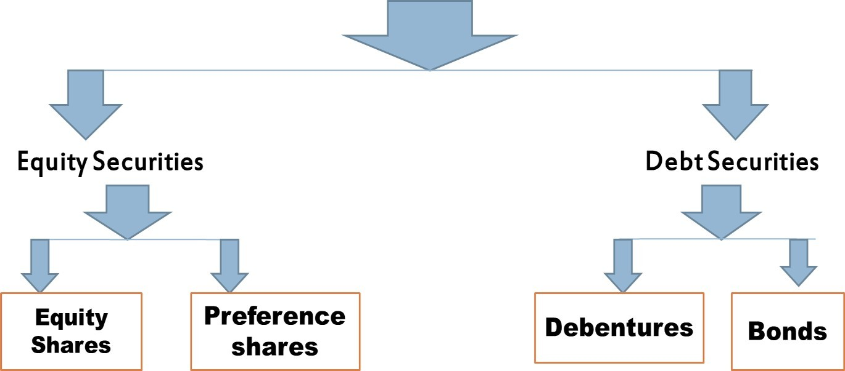
BASIC CAPITAL MARKET INSTRUMENTS

Slide 66
Capital market instruments
Long-Term Financial Instruments :
This sub-category comprises instruments with maturity longer than those of short- and medium term instruments. Some of the long-term instruments are as follows :
i) Equity Shares :
Equity shares are also termed as ordinary shares or common shares.
Holders of the equity shares are the owners of the company as they have invested in the company.
They have the voting rights and part of decision-making process on major issues relating to the affairs of the company.
The shareholders' return on the funds invested by them in the company is in the form of 'Dividend".

Slide 67





MERITS OF EQUITY SHARES
LIMITATIONS OF EQUITY SHARES
A permanent source of finance to the company
No fixed rate of dividend
Easy liquidity and marketability
No guarantee on returns to shareholders
Loss of managerial control

Slide 68
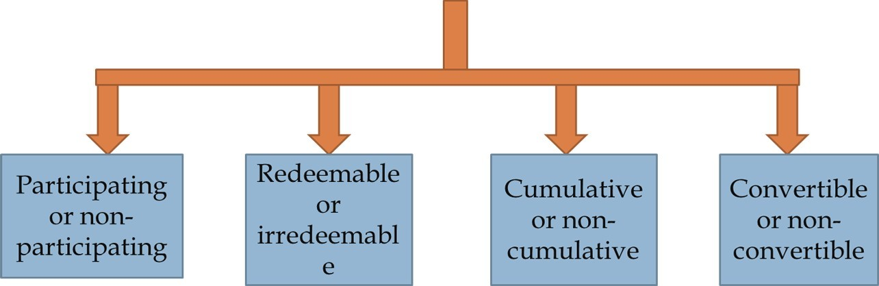
ii) Preference Shares :
Preference shares have the unique characteristics of being hybrid in nature, i.e., they have certain features of equity and at the same time certain features of debentures. It is similar to equity shares in the following ways :
From disposable profits, the dividend of preference shares is paid.
Preference dividend is not compulsory for the payment of fixed amount of dividend. It totally depends upon the director's decision.
There is no tax-deduction in Preference Dividend.

Slide 69
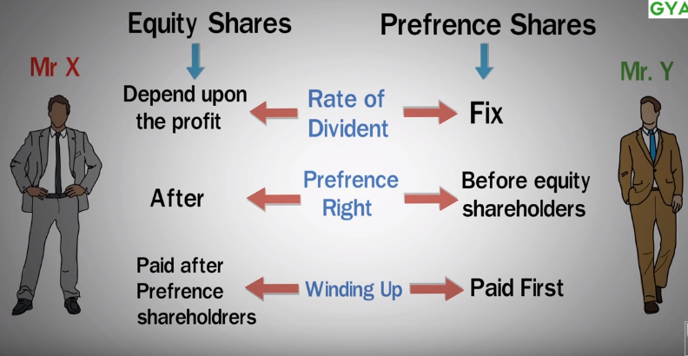

Slide 70
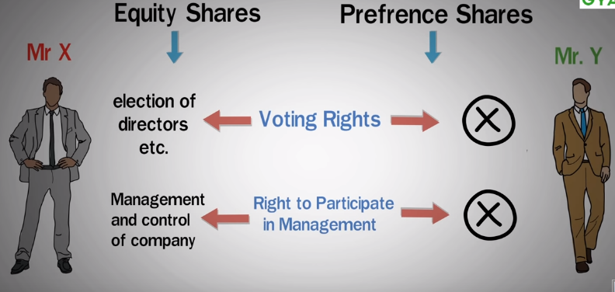

Slide 71


Slide 72
iii) Debentures :
A debenture is an instrument through which an Indian Public Limited Company can raise funds from the market.
A debenture is signed by the company with its seal, to acknowledge the debt of the person(s). ensuring the advanced amount of debt. So this is a security issued by a company against debt.
A company may issue debentures after getting Certificate of Commencement of Business, provided its Memorandum of Association contain a clause which permits the company to issue debentures.
Redeemable or irredeemable
Convertible or non- convertible
Secured or
unsecured
Bearer or
registered

Slide 73
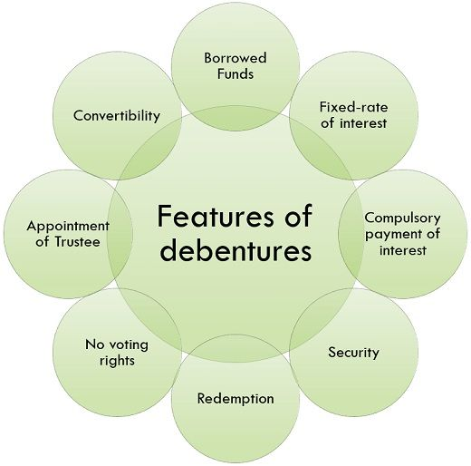

Slide 74
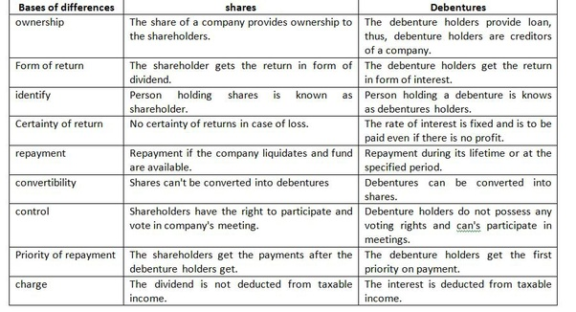

Slide 75
iv) Term Loan :
Term loans are loans procured for the acquisition of fixed assets and working capital margins and are repayable over a long period of time, generally ranging between one year and ten years.
Term loans are extended by banks and other financial institutions set up for the purpose of extending term finance.
Term loans differ from short-term bank loans, also known as 'Working Capital Finance', which are sanctioned by banks to meet day-to-day business requirements like purchase of raw material, work-in-progress and finished goods, etc. They are self liquidating over a period of time.

Slide 76
v) Bonds :
A bond is a debt security, in which the authorized issuer owes the holder a debt and is obliged to repay the principal and interest (the coupon) at a later date, termed maturity.
A bond is simply a loan in the form of a security with different terminology; the issuer is equivalent the borrower, the bond holder to the lender, and the coupon to the interest.
Bonds enable the issuer to finance long-term investments with external funds. Bonds are issued by public authorities, credit institutions, companies and supranational institutions in the primary markets.

Slide 77
TYPES OF BONDS
Bearer bonds
Registered bonds
Callable bonds
Convertible bonds
Zero coupon bonds
Fixed rate bonds

Slide 78
Bond | Debenture
A bond is a financial instrument showing the indebtedness of the issuing body towards its holders. | A debt instrument used to raise long term finance is known as Debentures.
Bonds are generally secured by collateral. | Can be Secured or Unsecured.
Low Interest Rates | High Interest Rates.
Issued by Govt Agencies, Financial institution, Corporation etc. | Issued by Public Companies
Accrued | Periodical payments

Slide 79
EQUITY SECURITY | DEBT SECURITY
Owner of the company. | Creditor of the company.
Get Dividend only when company earns sufficient profits. | Provides steady income to the investors.
Have voting rights. | No voting rights.
Not secured. | Secured in nature.
Share capital of the company. | Borrowed capital of the company.

Slide 80
Hybrid Instruments
Hybrid instruments have both the features of equity and debenture. This kind of instruments is called as hybrid instruments. Examples are convertible debentures, warrants etc.
A hybrid financial insturment is an investment that blends chearacteristics of both equity and debt markets (stocks and bonds).
The most common form of a hybrid instrument is the convertible bond, warrants.
This type of security is an issuance of debt that can be converted to a company's common stock at any given time. So, it is kind of like a call option.

